Slide 1
CAPTCHA recognition using convolution neural nets
By
Kireet Bharadwaj,
Manish Devatha,
Suganth Kumar

Slide 2

Steps Involved
1
2
3
4
5
6
7
8
9
10
Problem
Approach
Data Generation
Data Segmentation
Data Exploration
CNN Architecture
Training the Model
Testing the model
Insights
Recommendations and future scope

Slide 3
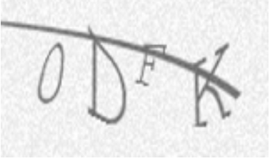
Problem
There are many important websites which still use the traditional Captcha which is a combination of Letters and Numbers and end up being at the risk of their data being updated automatically by bots
Captchas have defeated machines but things are changing rapidly as technology improves. Hence research into Optical Character Recognition(OCR) is required to strengthen Captchas against machine based attacks.
The goal of this project is to accurately classify the captchas which is a combination of letters and numbers along with some ‘noise’ included

Slide 4
approach
For a 4 sequence captcha there is 36x36x36x36 combinations that is 1,679,616 unique combinations increasing captcha length increases combinations.
To train captchas directly with Neural networks would require us to generate huge amount of data and computing resources to train the model.
Alternative approach is to make the model identify characters rather than mapping entire captcha.

Slide 5
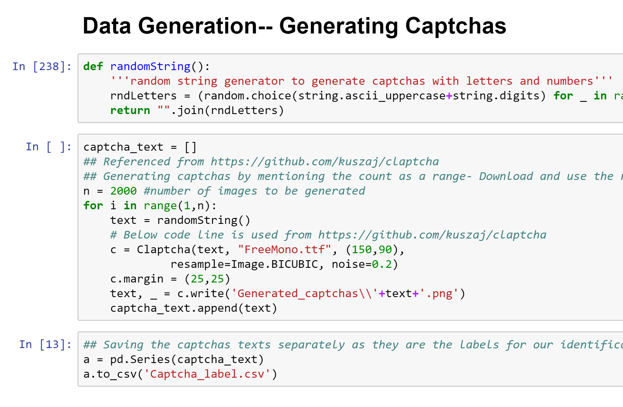
Data Generation
We wrote a random character generator and used Claptcha library in python to generate our own set of Captchas
Captcha we have generated is of a 4 character sequence and has random noise

Slide 6

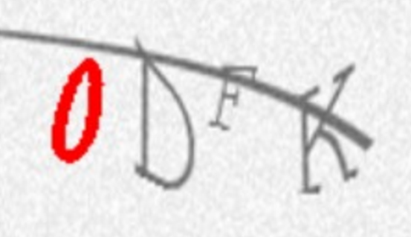
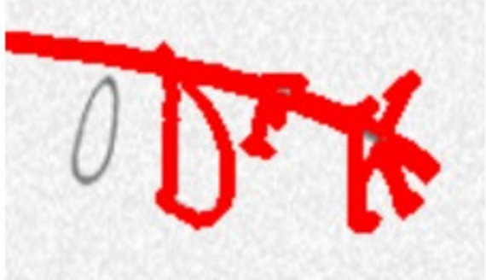
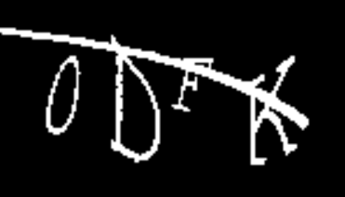
Data Segmentation
Because of the random line which is generated, spliting into characters based on contour technique is arduous.
We binarized the image using(black or white) using OTSU thresholding to remove background noise and then split the captcha into segments based on positioning and spacing of the characters in the captcha.

Slide 7
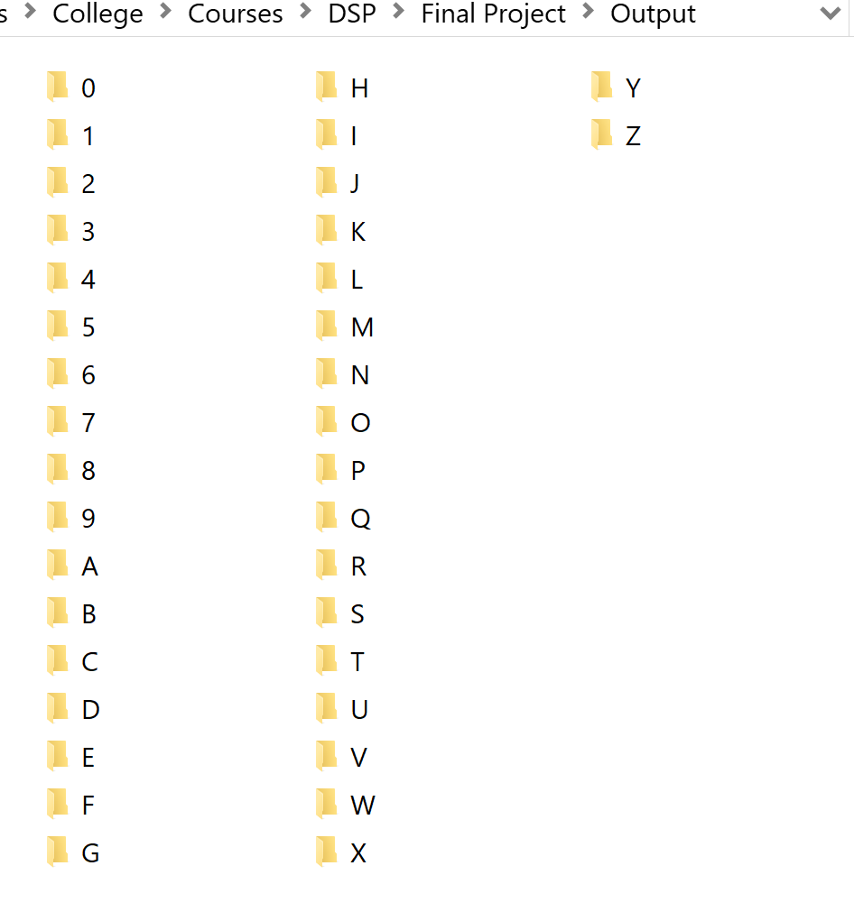
Data Exploration
We have generated our labeled data by splitting our captchas into characters
Data contains 36 characters 0-9 and A-Z with random noise in the images to make our classification complicated

Slide 8
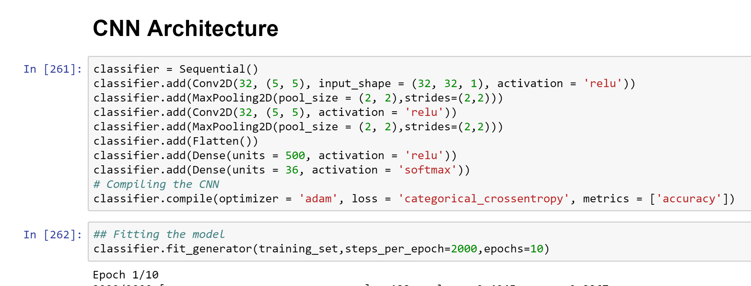
CNN Architecture
Implemented using Keras library
Model used - Sequential
Features – 32
Convolution
Maxpooling
Flattening
Dense layer
Optimizer - Adam

Slide 9
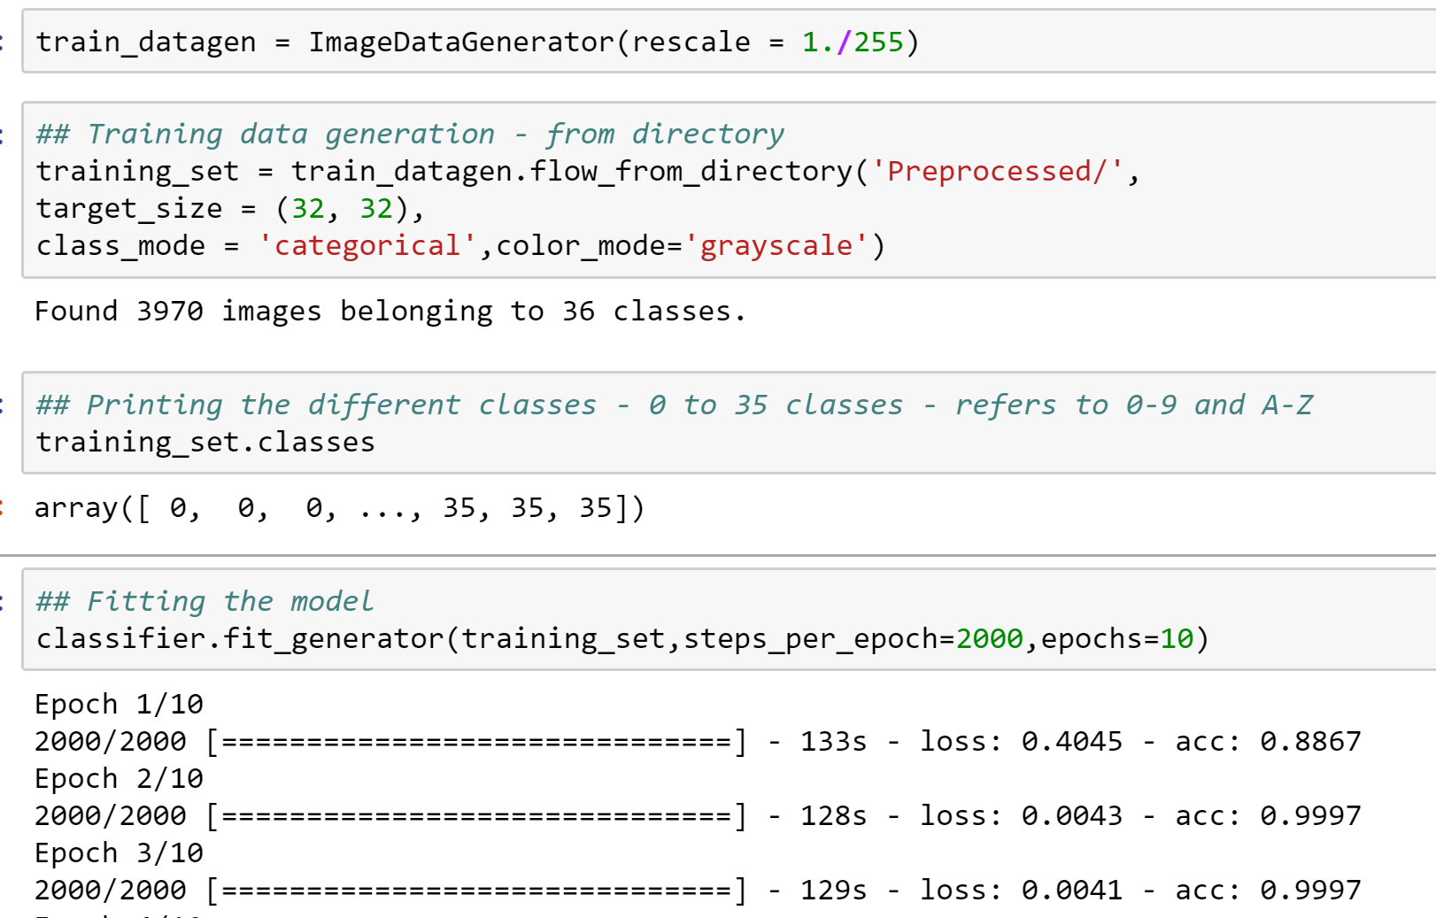
Training the Model
Rescaled and standardized the image using image data generator
Fitting the model using 10 epochs
Batch size – 32
Saved the trained model built in hierarchal data format

Slide 10
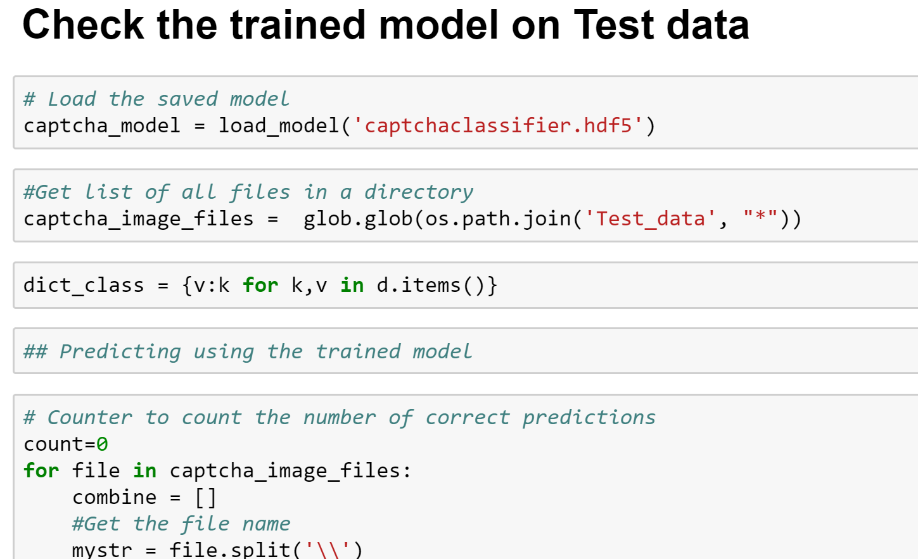
Testing the model
Loaded the save model
Processed the test images – Grey scaling, thresholding and slicing
Achieved overall model accuracy of 70%

Slide 11

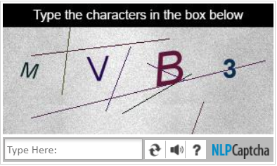
Insights
The applications containing Captchas with no ‘noise’ included are at the highest risk of being automated.
The Captchas with noise such as lines across the text are at a medium risk of a breach.
Observing the different captchas and its history we can find that there is always a space separating the letters in a captcha which makes these captchas vulnerable for machines to break them.
If the intensity of the noise is less than the actual text and if not converging on the text, the noise can be removed by thresholding or binarizing

Slide 12
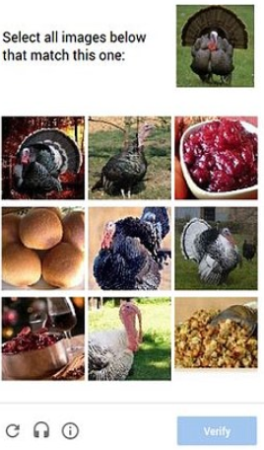
Recommendations and future scope
Captchas with Images or a combination of Images and text with varying intensity of noises is an efficient way to be used in applications and would be difficult for machines to learn the pattern.
As per Prof. Balaji’s recommendation, further extension is to classify and score a captcha based on human readability and complexity with respect to bots ability to process it.

Slide 13
References
The dataset is generated using python Claptcha library
https://becominghuman.ai/building-an-image-classifier-using-deep-learning-in-python-totally-from-a-beginners-perspective-be8dbaf22dd8
https://elitedatascience.com/keras-tutorial-deep-learning-in-python
https://github.com/kuszaj/claptcha

